Slide 1
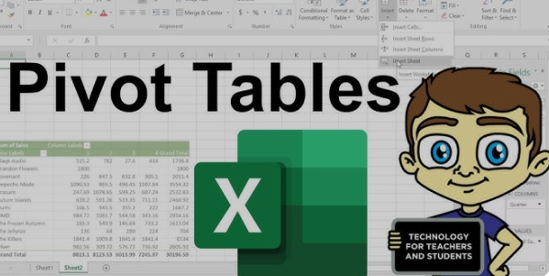

Slide 2
Pivot table
A pivot table is a data processing tool used in spreadsheet applications like Microsoft
Excel and Google Sheets. It allows users to summarize, analyze, and present large sets of
data in a more manageable format.

Slide 3
With a pivot table, you can:
Group data: Organize data by categories, such as dates, products, or regions.
Aggregate values: Perform calculations like sums, averages, or counts on the data
Filter data: Focus on specific subsets of your data to analyze.
Rearrange data: Change the layout of your data by dragging and dropping fields, making it easy to view different perspectives.

